Slide 1




Final Paper
Diamond Williams
The Immorality of Penal Labor
Introduction to Philosophy Honors PHI 2010H

Slide 2


Page 1
Simplified Argumentation
Premise 1: Forcing someone to do something they do not want to do that they have every right not to do is immoral*
Premise 2: Humans deserve rights and moral consideration
Premise 3: Criminals deserve to be treated as humans, they are deserving of rights and moral consideration
Conclusion: Penal labor is immoral
*Forcing someone not to harm another etc. is not immoral

Slide 3


Page 2
Moral Lacking
Criminals, delinquents, deviants, and prisoners deserve to be treated as humans. They are deserving of the rights and moral considerations that are stripped from them in penal labor.
Ethics are the very foundation of the criminal justice system. They're what helped us, as a society, to develop the moral reasoning we use to define criminal activity.
In my opinion, granting human rights to convicted criminals is necessary to maintain our humanity. As a society it is our duty to be just and humane to every individual, no matter their crime.
Of course, criminals are rightfully stripped of their ability to move about as they please or to experience luxury. It does not follow, however, that they forfeit their other rights simultaneously.

Slide 4
Objection & Response (1)
Page 3
Mitigation of recidivism & rehabilitation theory of punishment
  Penal labor mitigates recidivism
    Doing the ordinary, outside-world work helps cultivate self-esteem and self-worth; it gives them training and experience that can help them find employment after incarceration
  This calls on the rehabilitation theory of punishment, which seeks to prevent future crime by altering a criminal’s behavior.
Response
  There is no evidence of penal labor mitigating recidivism
  The jobs/positions that incarcerated individuals are trained for usually do not accept those with criminal histories

Slide 5

Objection & Response (2)
Page 4
Retribution Theory
  Those who commit wrongful acts morally deserve to suffer a proportionate punishment
  The Theory of Vengeance - Based on the doctrine of Lex talionis, which translates to 'an eye for an eye.'
  Why should prisoners sit with idle hands when the rest must work to put a roof over our heads and food in our bellies?
Response
  There is a lack of proportionality in regards to dealing out positions taken by incarcerated individuals.
  This theory does fit regarding lengths of sentences and locations of incarceration
institutions, but not for the occurrence of penal labor.

Slide 6

Objection & Response (3)
Page 5
We should not be concerned with criminals having rights/moral consideration
Response
  "Don’t workers behind bars deserve less than equal treatment? After all, they are murderers, criminals, sinners, and deviants.”
  People who do not behave like decent human beings do not merit being treated like decent human beings
  Consider series of risk factors
  We have to decide as a society, are we saying that we want people to be better when they are released or that we want to get revenge and punish people?
  Consider how these individuals became incarcerated
  Consider wrongfully convicted individuals

Slide 7


Page 6
History
The United States explicitly allows penal labor through the 13th Amendment of the Constitution, which states that "neither slavery nor involuntary servitude, except as a punishment for crime whereof the party shall have been duly convicted, shall exist within the United States, or any place subject to their jurisdiction."
Immediately following the ratification of the 13th amendment, the slave labor-dependent economy of the South faced collapse. Southern lawmakers began to exploit the loophole and turned to prison labor to restore the pre-abolition free labor force. The enforcement of Black Code laws effectively used the 13th amendment's exception of penal labor to reinvent the chattel slavery economy to comply with federal law.

Slide 8

Methodology & Prison-Industrial Complex
Page 7
  Prison-industrial complex (PIC) - describes the relationship between government and businesses
    According to this concept, incarceration benefits not only the justice system but also an extensive list of beneficiaries
  Contract system - officials sell the labor of inmates to private businesses
  Convict lease system - the state leases its prisoners to a business for a fixed annual fee and give up supervision and control
  The Public Account System - state-directed employment; the products are sold for state benefit

Slide 9










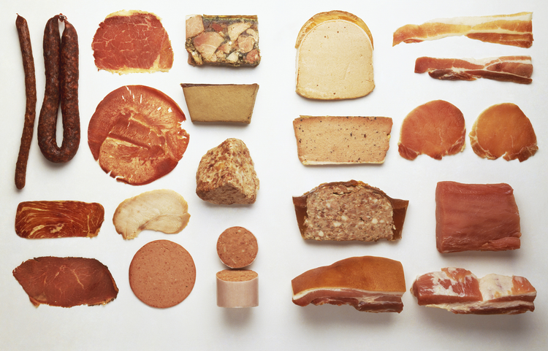



Slide 10


Page 9
Conclusion
  I suggest restorative justice as a replacement for a better fitting way to conceive of and think about justice. Defined as a system of criminal justice that focuses on the rehabilitation of lawbreakers through reconciliation with victims and the community, it is the only theory of punishment that possesses any capability to break the cycle of crime.
  Restorative justice would allow prisoners to form new positive self-identities and develop healthy social relationships that support them when they return home.
  Restorative justice practices work to address the rapid dehumanization in the traditional criminal justice system. Instead of viewing criminal acts as rule violations, restorative justice sees this action as a violation of people/relationships and an outburst of societal issues. Rather than focusing on the punishment, restorative justice measures determine how successfully harm is repaired.

Slide 11
References
Page 10
  “Penal Labour.” Wikipedia, Wikimedia Foundation, 21 Mar. 2022, https://en.wikipedia.org/wiki/Penal_labour.
  Goodman, J. David. “How Medical Care for Transgender Youth Became 'Child Abuse' in Texas.” The New York Times, The New York Times, 11 Mar. 2022, https://www.nytimes.com/2022/03/11/us/texas-transgender-youth-medical-care-abuse.html.
  Davis, Wynne. “Florida Gov. Ron DeSantis Signs a Bill Banning Abortions after 15 Weeks.” NPR, NPR, 14 Apr. 2022, https://www.npr.org/2022/04/14/1084485963/florida-abortion-law-15-weeks.
  Hernandez, Joe. “Oklahoma Governor Signs a Bill to Criminalize Most Abortions.” NPR, NPR, 12 Apr. 2022, https://www.npr.org/2022/04/06/1091291881/oklahoma-abortion-bill-ban-roe-v-wade.
  “Home.” Restorative Justice, 6 Apr. 2022, https://restorativejustice.org/.
  “Penal Labor in the United States.” Wikipedia, Wikimedia Foundation, 18 Apr. 2022, https://en.wikipedia.org/wiki/Penal_labor_in_the_United_States.
  Queram, Kate Elizabeth. “A Nebraska Law Bans People with Stds from Marrying. A Lawmaker Wants to Scrap It.” Route Fifty, Route Fifty, 13 Apr. 2021, https://www.route-fifty.com/management/2020/01/proposed-legislation-stds-married-nebraska/162551/.
  Benns, Whitney. “American Slavery, Reinvented.” The Atlantic, Atlantic Media Company, 7 June 2021, https://www.theatlantic.com/business/archive/2015/09/prison-labor-in-america/406177/.
  “The Uncounted Workforce.” NPR, NPR, 29 June 2020, https://www.npr.org/transcripts/884989263.
  “Types of Crimes and Their Punishments: Learn Criminal Justice.” Point Park University Online, 26 May 2021, https://online.pointpark.edu/criminal-justice/types-of-criminal-punishment/.
  “Federal Bureau of Prisons.” BOP, https://www.bop.gov/inmates/custody_and_care/work_programs.jsp.
  “Some Prison Labor Programs Lose Money - Even When Prisoners Work for Pennies.” NBCNews.com, NBCUniversal News Group, 2 Sept. 2021, https://www.nbcnews.com/news/us-news/some-prison-labor-programs-lose-money-even-when-prisoners-work-n1278326.
  Inmate Orientation Handbook - Florida Department of... http://www.dc.state.fl.us/pub/files/InmateOrientationHandbook.pdf.
  Siegel, Larry J., and John L. Worrall. Introduction to Criminal Justice. Cengage, 2022.

